Slide 1


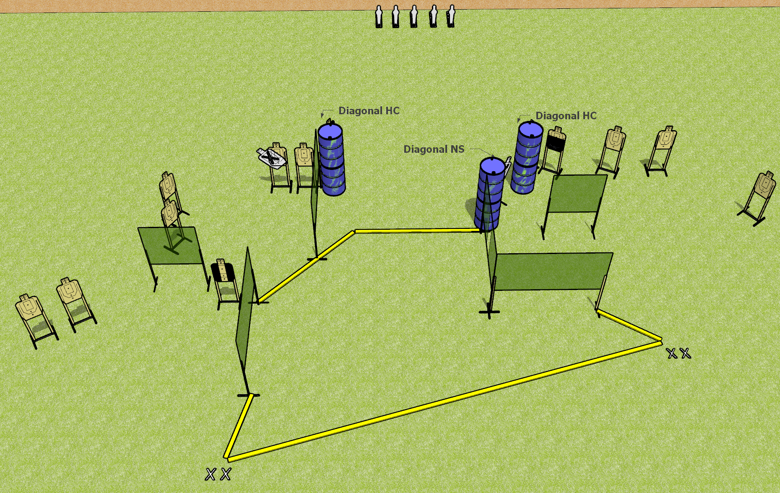
 | Dothan Gun Club – USPSA Match Fun in the Sun Course Designer : Drew Coleman
Round Count 33 rounds 14 USPSA targets 5 USPSA mini poppers
Equipment List 11 wall feet 1 tuxedo, 1 left diagonal and 1 right diagonal, 1 50% 2 medium fault lines

Slide 2
Fun in the Sun
Written Stage Briefing
Fun in the Sun is a 33 round, 165 point, Comstock field course. There are 14 USPSA targets and 5 USPSA mini poppers. The best 2 hits on paper will score, and steel must fall to score. The start signal is audible.
Handgun start position is both feet on either set of X’s, wrists below belt. Handgun is loaded and holstered.
PCC start position is both feet on either set of X’s. Loaded carbine is held with both hands, stock on belt, safety on.
On start signal, engage targets as they become available from within the shooting area.

